Slide 1
Building on the Microsoft Graph: 0 – App in 60 minutes
50
Gavin Barron
Solution Architect, Intergen

Slide 3




About me
Gavin Barron
Solution Architect
gavin.barron@teamintergen.com
@gavinbarron
http://gavinb.net
4x SharePoint Server MVP
Building on SharePoint since 2007
Building on Office since 2002

Slide 4
Graph Overview

Slide 5
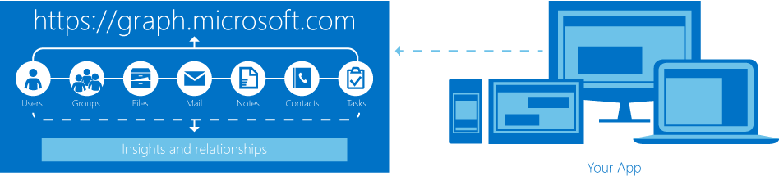
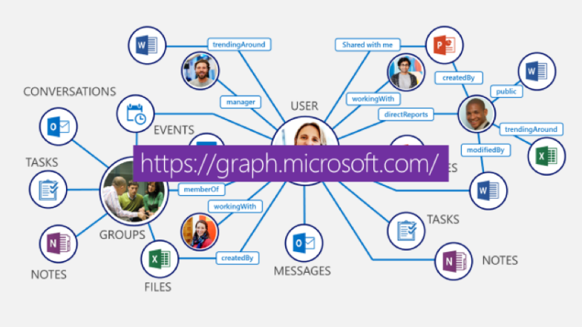
What’s this Graph thing?
AKA Office 365 Unified API
Incorporating some elements from Office Graph
A single API for (almost) all O365 data
/v1.0 - stable
/beta - new calls subject to breaking change
Secured using Azure Active Directory

Slide 6
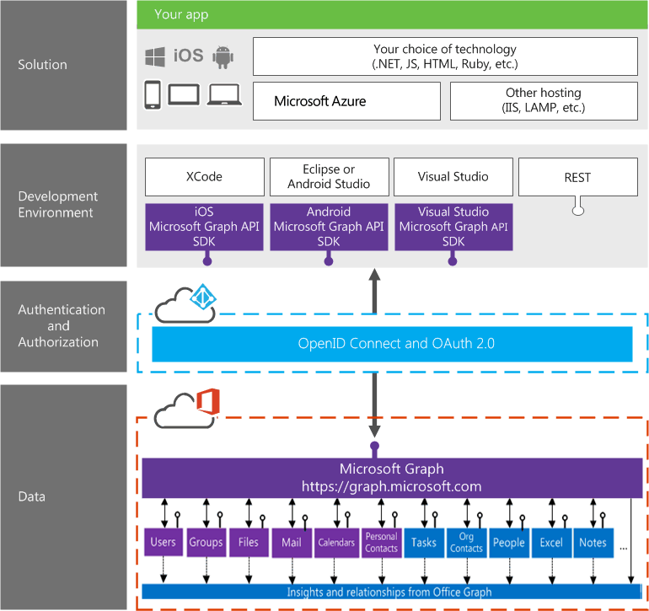
What’s this Graph thing?
RESTful API built for use in the modern web

Slide 7
Authentication

Slide 8
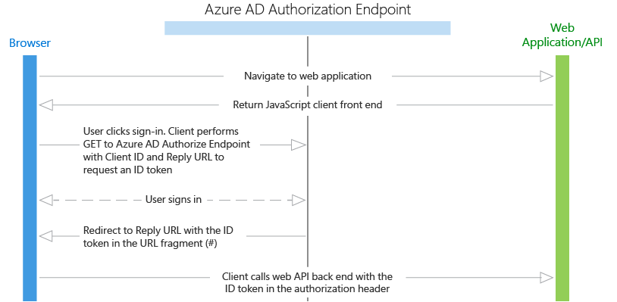
Authentication with Azure Active Directory
OAuth 2.0 Implicit Flow

Slide 9
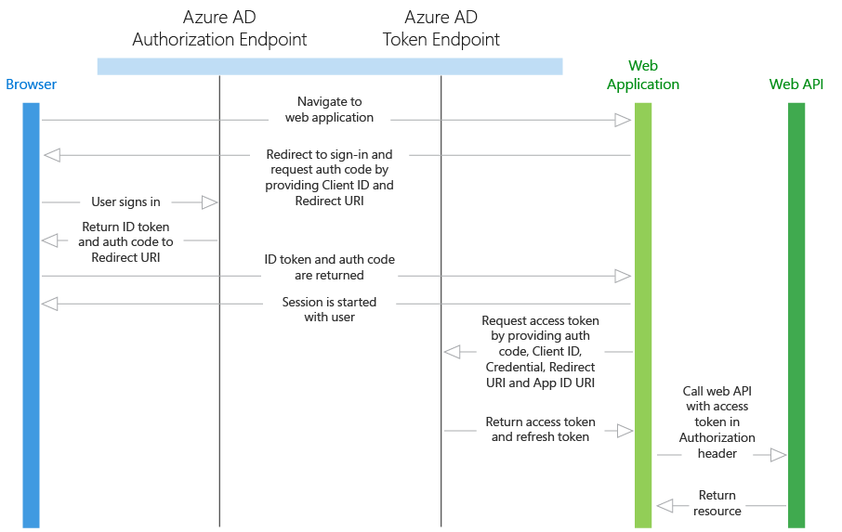
Authentication with Azure Active Directory
OAuth 2.0 Authorization Code Grant

Slide 10
Let’s build an Application!

Slide 11


Let’s Build an App!
Sketch a wireframe
Plan Graph API calls to retrieve data
Azure AD Application
AngularJS SPA with ADAL.js
Scaffolded with Yeoman
Angular Material for tidy UI
You could use ngOfficeFabric ;)
Web page title
http://www.url.com
emailAddress
Find Files
Image 1
Image 2
Image 3
Save to SharePoint

Slide 12
Graph Explorer

Slide 13
Azure AD Application

Slide 14
AngularJS Application

Slide 15




spca.biz/XHGV
@gavinbarron
Gavinb.net
Github.com/gavinbarron

